Slide 1
OBJECT ORIENTED ANALYSIS AND DESIGN
UNIFIED PROCESS AND USE CASE DIAGRAMS
By
K.SHENBAGAVALLI , AP/CSE
JCE

Slide 2
Why is OOAD Important?
It allows effective management of s/w complexity by the efficiency of
modularity.
OOAD skills are essential for the creation of well-designed, robust and maintainable s/w using object oriented technologies and languages.

Slide 3
OO Basics
Class
Objects
Attributes
Methods
Objects respond to messages
Polymorphism
Class hierarchy
Inheritance
Object relationships and associations
Aggregations
Static & dynamic binding
Object persistence

Slide 4


Process Steps in OOAD
Define use cases
Define a domain model
Define interaction diagrams
Define design class diagrams
Eg. Play a dice game:
2 dice available;
A player rolls the dice; If the total is 7, he wins; Otherwise he loses

Slide 5
Process Steps in OOAD
1. Define use cases
Requirement analysis application
Written as use cases
Not object oriented
🡪 stories / scenarios of how people use the
Eg. Play a dice game: Use cases
Player requests to roll the dice
System presents the results
If the face value of the dice totals 7, player wins; otherwise the player loses

Slide 6
Player
1 Rolls 2
Die
Process Steps in OOAD
name
face_value
1
Plays 1
2
2. Define a Domain Model
DiceGame
1
Includes
Object oriented analysis 🡪 domain description from the perspective of objects.
Identification of concepts, attributes and associations – results expressed in a domain model 🡪 it shows domain concepts / objects
Eg. Play a dice game: Domain Model
Gives a visualisation of the concepts of a real- world domain 🡪 called as conceptual object model

Slide 7
Process Steps in OOAD
3. Assign object responsibilities and Define (or Design) Interaction Diagrams
: DiceGame
d1 : Die
d2 : Die
Object oriented design 🡪
rollDice( )
concerned with defining s/w
objects, their responsibilities and collaborations.
fv1 = getFaceValue( )
rollDice( )
Sequence diagram – a notation that shows the flow of messages between software objects, and thus the invocation of methods.
fv2 = getFaceValue( )
Eg. Play a dice game: Sequence diagram (partial)

Slide 8
Process Steps in OOAD
3. Define Design Class Diagrams
DiceGame
die1 : Die die2 : Die
play( )
Die
faceValue : int die2 : Die
getFaceValue( ) roll ( )
Design class Illustrates the
diagram 🡪
attributes and
1
2
methods of the classes.
Shows the s/w classes.
Class names and contents similar to domain model
Eg. Play a dice game: Design Class diagram (partial)

Slide 9
ITERATIVE, EVOLUTIONARY AND AGILE – DEVELOPMENT PROCESS

Slide 10
Iterative and Evolutionary Development
A key practice in of the modern methods – Eg. Unified process
In this lifecycle approach, development is organized into a series of short, fixed- length (for example, three-week) mini-projects called iterations
The outcome of each is a tested, integrated, and executable partial system.
Each iteration includes its own requirements analysis, design, implementation, and testing activities.
The system grows incrementally over time, iteration by iteration, and thus this
approach is also known as iterative and incremental development.
Because feedback and adaptation evolve the specifications and design, it is also known as iterative and evolutionary development.

Slide 11
Iterative and Evolutionary Development
The system may not be eligible for production deployment until after many iterations;
eg., 10 or 15 iterations.
Each iteration involves choosing a small subset
designing, implementing, and testing.
In addition to requirements clarification, activities such as load testing will prove if the partial design and implementation are on the right path, or if in the next iteration, a change in the core architecture is required.
In early iterations the deviation from the "true path" of the system (in terms of its final requirements and design) will be larger than in later iterations. Over time, the system converges towards this path.
of the requirements, and quickly

Slide 12
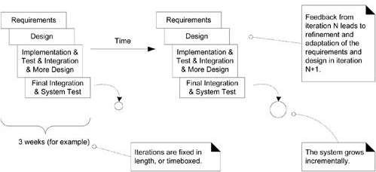
Iterative and Evolutionary Development

Slide 13

Iterative and Evolutionary Development
Benefits of Iterative Development
less project failure, better productivity, and lower defect rates
early rather than late mitigation of high risks
early visible progress
the learning within an iteration can be methodically used to improve the development process itself, iteration by iteration
early feedback, user engagement, and adaptation, leading to a refined system
managed complexity

Slide 14
Iterative and Evolutionary Development
What is Iteration Time boxing?
Most iterative methods recommend an iteration length between two and six weeks.
Small steps, rapid feedback, and adaptation are central ideas in iterative
development.
Long iterations subvert the core motivation for iterative development and
increase project risk.
A very long time-boxed iteration misses the point of iterative development. Short is good.
Iterations are time-boxed, or fixed in length. Date slippage is illegal.
If it seems that it will be difficult to meet the deadline, the recommended response is to de-scope-remove tasks or requirements from the iteration, and include them in a future iteration, rather than slip the completion date.

Slide 15
Iterative and Evolutionary Development
What is the Need for Feedback and Adaptation?
In complex, changing systems feedback and adaptation are key ingredients for success.
Feedback from
Early development, programmers trying to read specifications, and client demos 🡪 to refine the requirements.
tests and developers 🡪 to refine the design or models.
the progress of the team tackling early features 🡪 to refine the schedule and estimates.
the client and marketplace to re-prioritize the features 🡪 to tackle in the next
iteration.

Slide 16
Iterative and Evolutionary Development
What is Risk-Driven and Client-Driven Iterative Planning?
The Unified Process encourages a combination of risk-driven and client-driven iterative planning.
This means that the goals of the early iterations are chosen to
identify and drive down the highest risks, and
build visible features that the client cares most about.
Risk-driven iterative development 🡪 includes more specifically the practice of architecture-centric iterative development, i.e early iterations focus on building, testing, and stabilizing the core architecture.

Slide 17
AGILE METHOD
What is Agile Methodology?
The Agile methodology is a way to manage a project by breaking it up into several phases.
It involves constant collaboration with stakeholders and continuous improvement at every stage.
Once the work begins, teams cycle through a process of planning, executing, and evaluating.
Continuous collaboration is vital, both with team members and project stakeholders.
5 main Agile methodologies: Scrum, Kanban, Extreme Programming (XP), Lean Development and Crystal

Slide 18
AGILE METHOD
Agile development methods
apply time boxed iterative and evolutionary development,
employ adaptive planning,
promote incremental delivery (Incremental 🡪 a team delivers work in small packets of end-to-end functionality)
include other values and practices that encourage agility rapid and flexible response to change.
Promote practices and principles that reflect simplicity, lightness, communication, self-organizing teams, etc.

Slide 19
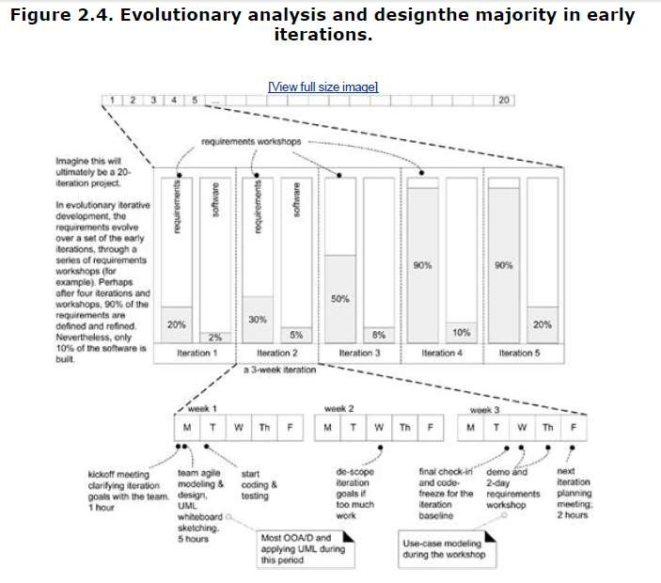
AGILE METHOD

Slide 20
AGILE METHOD – THE AGILE MANIFESTO
Agile methods support uncovering better ways of developing a s/w by doing it and helping others do it.
The Agile Manifesto of Software Development put forth a groundbreaking mindset on delivering value and collaborating with customers when it was created in 2001.
Agile's four main values are:
Individuals and interactions 🡪 over processes and tools
Working software 🡪 over comprehensive documentation
Customer collaboration | 🡪 | over contract negotiation
Responding to change | 🡪 | over following a plan

Slide 21
AGILE METHOD – THE AGILE PRINCIPLES
1. Our highest priority is to satisfy the customer through early and continuous delivery of valuable software.
2. Welcome changing requirements, even late in development. Agile
processes harness change for the customer's competitive advantage.
Deliver working software frequently, from a couple of weeks to a couple of months, with a preference to the shorter time scale.
Business people and developers must work together daily throughout the project
Build projects around motivated individuals. Give them the environment and support they need, and trust them to get the job done.
The most efficient and effective method of conveying information to and within a development team is face-to-face conversation.

Slide 22
AGILE METHOD – THE AGILE PRINCIPLES
Working software is the primary measure of progress.
Agile processes promote sustainable development.
The sponsors, developers, and users should be able to maintain a constant pace indefinitely
Continuous attention to technical excellence and good design enhances agility
Simplicity the art of maximizing the amount of work not done is essential
The best architectures, requirements, and designs emerge from self- organizing teams.
At regular intervals, the team reflects on how to become more effective, then tunes and adjusts its behavior accordingly.

Slide 23
UNIFIED PROCESS
Definition
UP Phases
UP Disciplines

Slide 24
UNIFIED PROCESS (UP)
DEFINITION:
A software development process that describes an approach to building, deploying, and possibly maintaining software.
UP is a type of framework, which is used for UML in software engineering.
It is a popular iterative and incremental software development process which should be customized for specific organization or project.
It is based on the enlargement and refinement of a system through multiple iterations, with cyclic feedback and adaptation.

Slide 25
UNIFIED PROCESS (UP)
The UP has emerged as a popular iterative software development process for building object-oriented systems.
Widely adopted method 🡪 The Rational Unified Process or RUP 🡪 a detailed refinement of the UP.
The UP combines commonly accepted best practices, such as an iterative lifecycle and risk-driven development, into a cohesive and well-documented process description.

Slide 26
UNIFIED PROCESS (UP)
A key practice in UP is iterative development.
Need for UP:
The UP is an iterative process.
UP practices provide an example structure for how to do and thus how to explain OOA/D.
The UP is flexible, and can be applied in a lightweight and agile approach that includes practices from other agile methods.

Slide 27
UNIFIED PROCESS PHASES
A UP project organizes the work and iterations across four major phases:
PHASES DESCRIPTION
Inception
approximate vision, business case, scope, vague estimates
Elaboration
refined vision, iterative implementation of the core architecture, resolution of high risks, identification of most requirements and scope, more realistic estimates
Construction
iterative implementation of the remaining lower risk and easier elements, and preparation for deployment.
Transition
beta tests, deployment

Slide 28
UNIFIED PROCESS PHASES
INCEPTION:
Initial short step to establish a common vision and basic scope for the project
Not a requirement phase
Feasibility phase
Enough investigation done to support a decision to continue or stop.
Analysis of critical non-functional requirements
Case studies precede this phase
Use cases created 🡪 to elaborate the user scenario
2 major activities 🡪 communication & planning

Slide 29
UNIFIED PROCESS (UP)PHASES
ELABORATION:
Not the requirements or design phase
Phase where the core architecture is iteratively created
High risk issues are mitigated.
Use cases redefined 🡪 an architectural representation is created.
An executable baseline created
Then a plan created 🡪 to check whether scope, risks and delivery dates are reasonable.
2 major activities 🡪 planning & modelling

Slide 30
UNIFIED PROCESS (UP)
CONSTRUCTION:
Main activity 🡪 making the use case operational.
Analysis and design activities started in elaboration phase are completed
Source code is developed 🡪 all desired functional requirements
Unit testing and acceptance testing carried out

Slide 31
UNIFIED PROCESS (UP) – UP PHASES
TRANSITION:
All activities required at the time of deployment of the s/w product carried out
Beta testing conducted when the s/w is delivered to the client
User feedback used to remove defects
Finally, manuals installation guides, troubleshooting procedures prepared and provided to make the s/w more usable

Slide 32
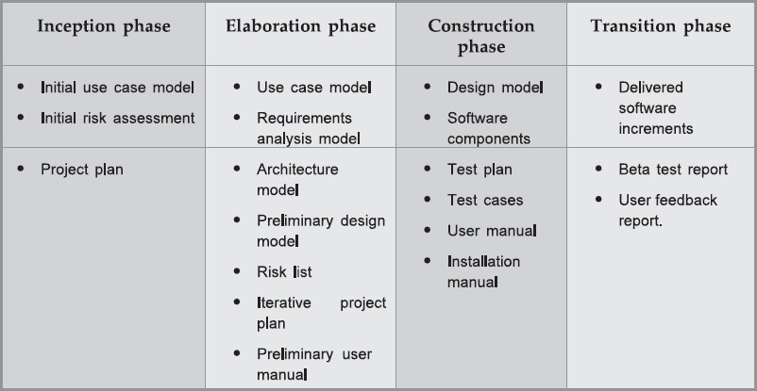
UNIFIED PROCESS (UP) – UP PHASES

Slide 33
UNIFIED PROCESS (UP) – UP DISCIPLINES
Represent the set of activities in some specific subject area Eg. activities within requirement analysis
Artifact 🡪 refers to any product 🡪 code, web graphics, db schema, text documents, diagrams, etc.
Basic disciplines:
Business modeling
Requirements
Analysis & Design
Implementation
Testing
Deployment
Configuration & change management
Project management
Environment

Slide 34
UNIFIED PROCESS (UP) – UP DISCIPLINES
Basic disciplines:
Business modeling 🡪 domain model 🡪 to visualize noteworthy concepts in the application domain
Requirements 🡪 use-case model 🡪 to capture functional and non-
functional requirements
Design 🡪 design model artifact 🡪 to design s/w objects Implementation 🡪 programming and building the system
Environment 🡪 establishing the tools and customizing the process for that project, setting up the tools, etc.

Slide 35
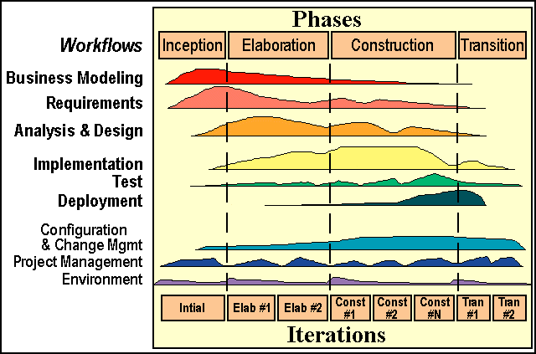
UNIFIED PROCESS (UP) – UP DISCIPLINES

